Slide 1
Malware Analysis & Reverse Engineering (Spring’19; Mon. 8am)
Saman Zonouz

Slide 2
About our research group 4N6…
Research
Security and Privacy
Cyber-Physical Systems
Intrusion Detection and Response
Embedded and Operating Systems Security
Reverse Engineering and Malware Analysis
Trustworthy Cyber-Physical Critical Infrastructures

Slide 3
Intro!
Research Group
4N6 Cyber Security and Forensics Research Group
Looking for motivated students
Email: mare2019ece@gmail.com (Do not send emails to other addresses)
I will check this email once per week (on Fridays).
Website: http://rci.rutgers.edu/~sa1087
Office hours: Monday mornings
One hour after each class at the class location

Slide 4
Course outline…
Warning
Course Material
Course Goals
Paper Reading
Paper Summaries
Projects
Grading Policy
Other Class Policy
Action Items

Slide 5
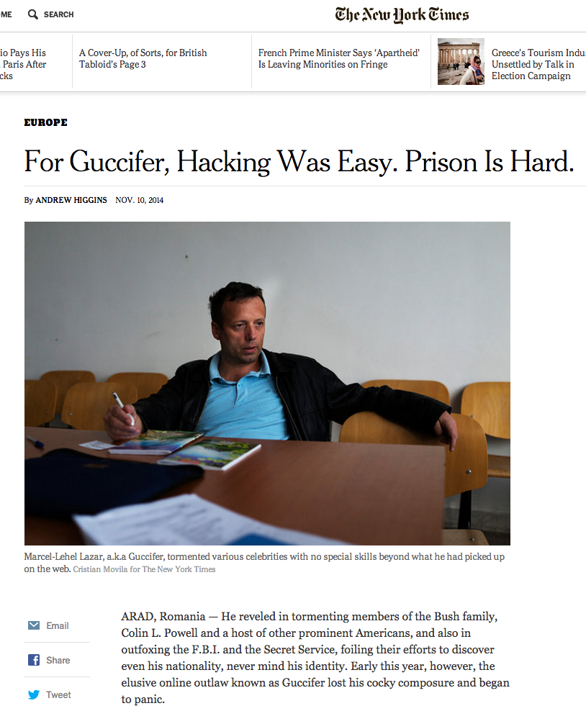
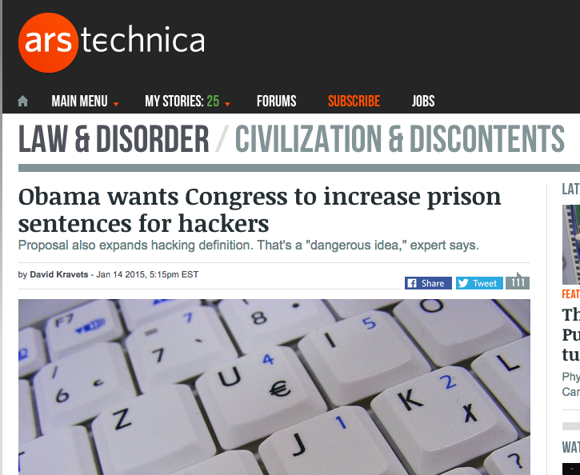
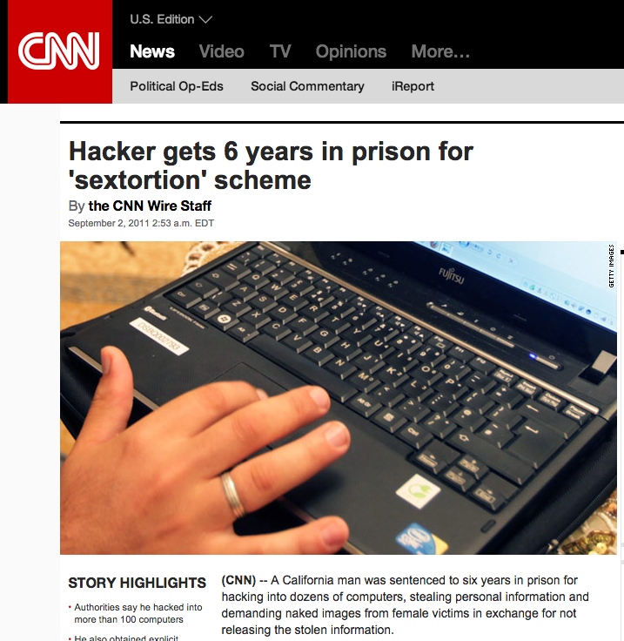
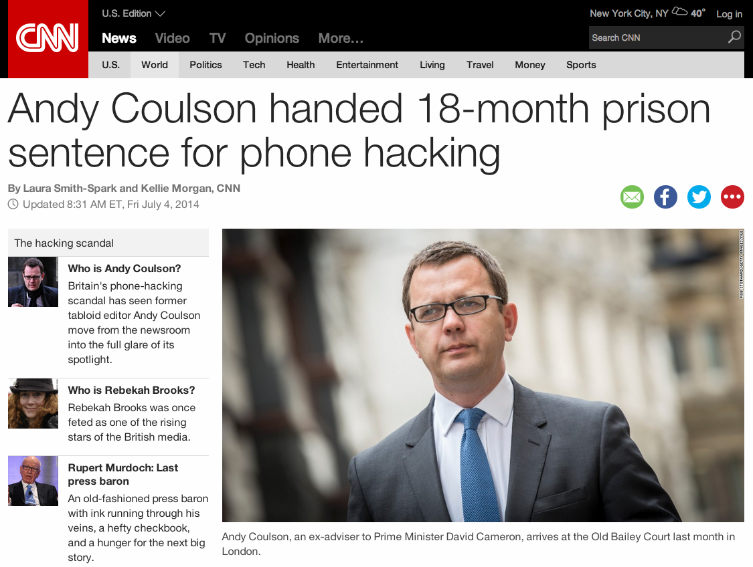
***WARNING***
http://abcnews.go.com/GMA/video/cyber-hacker-sentenced-20-years-10208493
http://en.wikipedia.org/wiki/List_of_computer_criminals

Slide 6
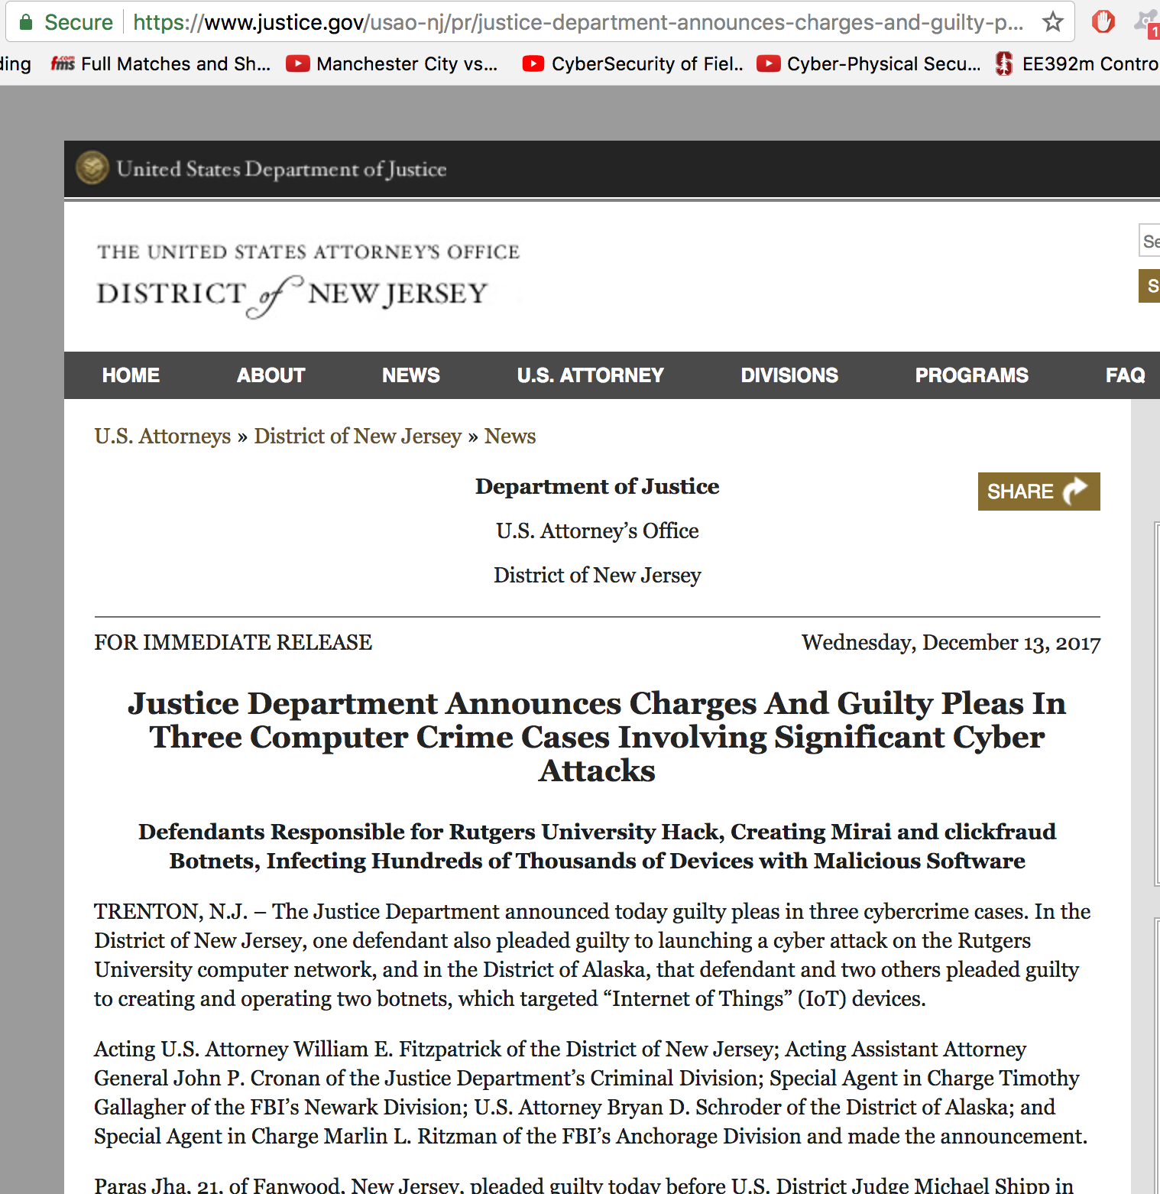
Rutgers cyber attacks by a former student (10yrs + $250K))

Slide 7
***WARNING***
Responsible and ethical malware analysis and reverse engineering (tons of online docs; e.g., Ethical Hacking)
Simple (and incomplete) rules
Do NOT reverse engineer commercial software
Do NOT run a malware on others’ computers or in an uncontrolled/connected environment/system setup
Consequences could be catastrophic!
If are not sure about doing something, it is most likely wrong/unethical.
What I would like to do
we learn about malware analysis and reverse engineering
What I do NOT want to do
I talk with Rutgers IT security people or FBI law enforcement
Some facts
What you do in cyber world could be easily traced back!
End-to-end encryption/security/privacy is a hoax!
http://ethics.csc.ncsu.edu/intellectual/reverse/study.php

Slide 8
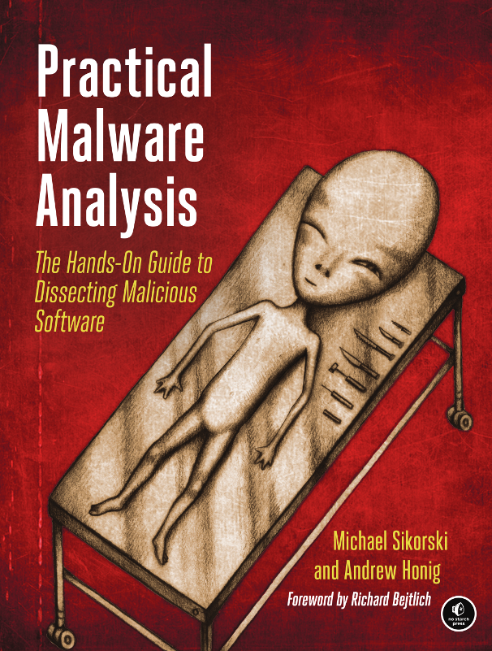
Course Material
We will be using Sakai
Will set up over the weekend
Will contain papers, malware.ex_, slides, etc.
Textbook
Practical Malware Analysis by Michael Sikorski and Andrew Honig, 2012

Slide 9
Course goals
Method of learning
Group learning
Critically reading and analyzing research papers
Presenting papers
Project work
Outcomes :
Understanding of hands-on experience with cyber attacks, malware, their functionalities, and reverse engineering analysis --- applications, characteristics, and the principal issues involved
Learn to read research papers
Learn to write research papers
Learn to perform research in a relatively new area
Learn to analyze malware and write your own “malware”
Learn to lead discussion + communicate ideas in a clear fashion

Slide 10
Class Structure
Three components
Lectures
Videos
Practical/hands-on
Student presentations
More details coming…

Slide 11
Teamwork!
Almost everything in class will be done/delivered by teams
Form your team by next week Feb 11th
Names/emails of 3 students
Pick your teammates carefully (semester-long fixed teams)
A good/bad teammate makes a big difference!
Collaboration on presentations, projects, quizzes, etc.

Slide 12
Student Presentations
Each team will be presenting 2 presentations at one class
Each presentation
19min < duration < 21min
will include 1 research paper and 1 malware
needs to be technical
by two students

Slide 13
Paper Presentations
We will study about one research paper in details in each class
Read the paper very thoroughly (ALL sections)!
Slides need not be a section by section copy of the paper
Should cover (at least):
What is the problem being address?
Goal of the paper
Why should we care?
Motivation
What is the approach?
Details of the approach
Experimental setup
What are main results?
Did they achieve what they set out to do?
Related work
Future Work: Where do we go from here?
Your opinion on the paper and what can be done to improve it
This will be followed by discussion of the paper in class

Slide 14
Paper Selection
Pick your papers carefully
Needs to be a fundamental work
Workshop papers not accepted
Top security conferences:
Only USENIX Security, CCS, NDSS, IEEE S&P Oakland, DSN.
Send me the paper’s title one week (Monday) in advance for approval (mare2019ece@gmail.com)
Read the paper carefully & several times
Must be beneficial for yourself, and the class
Send me a 2 page critical review of the paper on Friday before your presentation week

Slide 15
Paper Reviews/Summaries
Summary should cover (no text copied from the paper)
Problem being addressed --- a short paragraph at most
Motivation for the importance of the problem as stated in the paper
Solution approach --- one/two sentences
Pros and Cons of the paper
Focus on technical aspects ( problem formulation, solution, experiments and analysis)
What would you do differently ? Why ? (think outside the box, justify)

Slide 16
Malware Presentation
Pick/download/analyze/report what one real malware sample does!
Popular websites
http://www.offensivecomputing.net/
http://www.exploit-db.com/
https://ics-cert.us-cert.gov/
https://nvd.nist.gov/
http://www.metasploit.com/
and many more…

Slide 17
Malware Presentation
Pick malware one week before your presentation (Monday) and submit its link for approval
Submit your report on Friday before your presentation week

Slide 18
Malware Report/Presentation
3-page report (word default format – single spacing)
Must contain
Introduction: What the malware does (through your investigation or external reports)
Reverse engineering: how YOU DID confirm what it does
Static/dynamic analysis (show us assembly, screenshots of the tools you used, possibly live demos!)
Presentation need to be technical (NOT Descriptive)
Intrusion detection: how you would detect if a computer has been infected by such a malware
Intrusion recovery: how would you recover a compromised system

Slide 19
Student Presentation
It’s the group’s responsibility to complete reading the paper and analyzing the malware
The combined report will be 5 pages
In the report, indicate who did what
Take your presentations/reports seriously!
As a courtesy to the audience (and if you care about grades)

Slide 20
Lecture Topics (tentative)
Session | Main Topics
1 | Administratives, Introduction to MARE, Basic Static Techniques
2 | VM-based analysis, basic dynamic analysis, x86 binary disassembly
3 | IDA Pro, C constructs in PE, Windows malware
4 | Debugging, OllyDbg, kernel debugging/WInDbg
5 | Malware behavior, covert malware launching
6 | Data encoding, network IDS signatures
7 | Anti-disassembly techniques
8 | Anti-debugging approaches by malware
9 | Anti-VM, Binary (un)packing methods
10 | Midterm
11 | Shellcode analysis and return-oriented programming
12 | C++ analysis, 64-bit malware
13 | Symbolic execution and taint analysis
14 | Control system malware and social engineering

Slide 21
Student Presentations
Session | Date | Student teams
1 | 2/4 | N/A | N/A
2 | 2/11 | N/A | N/A
3 | 2/18
4 | 2/25
5 | 3/4 | N/A | N/A
6 | 3/11
7 | 3/25
8 | 3/19
9 | 3/26
10 | 4/1 | Midterm
11 | 4/8
12 | 4/15
13 | 4/22
14 | 4/29

Slide 22
Semester-Long Project
Semester-long research project to be done in teams of 3 people (transparent reporting → no slackers)
Team selection deadline: Feb 11th 2018
Each team works on a separate research problem that involves implementing some innovative attack, or malware-related defense
Either formulate your own problem or come talk to me
3-page Proposal deadline: Feb. 18 2018
Specify your project type: 1) research paper; 2) course report (I will devote time and grade accordingly)
Projects will involve additional project-specific background reading. Each project is expected to produce a publication-quality report at completion.

Slide 23
Project
The project grade component criteria includes: problem formulation, literature review, novelty of proposed solution, detailed nature of implementation of experiments/measurements
The project will have four reports submissions over the course of the semester building toward a paper (Latex typed; sug.: overleaf.com)

Slide 24
Project Deadline
Feb 18: Preliminary Report due, should cover
Problem statement
Motivation
Mar 26: Progress Report due, should cover
Literature review
Methodology
Apr 15: Results Report due, should cover
Experimental setup
Results
May 6th: Final report and delivery due, should cover
Introduction
Design
Implementations
Results
Conclusion

Slide 25
Grading Policy
Class Participation (30%): The class participation grade component will be judged on criteria including: quality of participation in class discussions, class presentation(s), and critical review of papers. Roughly, the grade breakup for participation will be as follows:
20% - Class presentation
7% - Paper/malware summaries
3% - Paper discussion participation
Research Project (40%): Roughly, the grade breakup for participation will be as follows:
5% - Novelty of the problem + Ability to motivate its need • [5% - Project Preliminary report]
5% - Thoroughness of Related Work + Novelty of solution • [5% - Project Progress Report]
20% - Quality of experimental results • [5% - Project Results Report]
10% - Final paper
Midterm/HWs/Quizzes (30%)
THE MOST IMPORTANT: ACADEMIC HONESTY
Deadlines are FIRM. No Extension. No makeups.

Slide 26
In-Class Hands-on Sessions
Always bring your laptop in class if you do have one
Otherwise, find a friend who does and sit together
Sit next to your teammates
Install
Virtualbox
VM: Windows XP 32bit
CFF-Explore (ExplorerSuite), nmap, wireshark, PracticalMalwareAnalysis-Labs, Regshot, ApateDNS, DependencyWalker, OllyDbg110, IDA Pro, PEiD, Peview, SysinternalsSuite, …
VM: Linux (Ubuntu 14.04) 32bit
Inetsim, Snort, …
Get VMs talk with each other
http://www.fitzweekly.com/2016/04/download-windows-virtual-machine-images.html
https://npackd.appspot.com/p/xp-ie6-virtualbox/2014.10.27

Slide 27
Office Hours
One hour after the class on Monday mornings
Please do not ask me (x25)
how to install/configure a software on a laptop (course prerequisites)
how to solve a HW problem (let’s discuss in class)
last minute questions before the submission deadlines (indication of a last-minute behavior)

Slide 28
Action Items
Paper titles for approval one week before your presentation
Paper critical reviews on Friday before your presentation week
Create the Windows/Linux setup by Feb. 11th
Project/presentation team information (names/emails of 3 people) by Feb. 11th
Project proposal by Feb. 18th

